Slide 1
Bank marketing analysis
AKSHAY GERA

Slide 2
Want to have a full interactive experience of the visuals?
Find the visuals on my tableau public link:
https://public.tableau.com/views/BankMarketingFinal/Dashboard1?:language=en-US&:display_count=n&:origin=viz_share_link

Slide 3
AGENDA
Background
Data Description
Data Visualization and Observations
Putting it All Together: Dashboard
Conclusions

Slide 4
Background
The data is related with direct marketing campaigns of a Portuguese banking institution. The bank is trying to market its product through tele-calling.
The product being marketed by the bank is their Term Deposit, which is our target variable containing 'yes' or ‘no’.
Often, more than one contact to the same client was required, in order to access if the product (bank term deposit)
Data Source: https://archive.ics.uci.edu/ml/datasets/bank+marketing

Slide 5
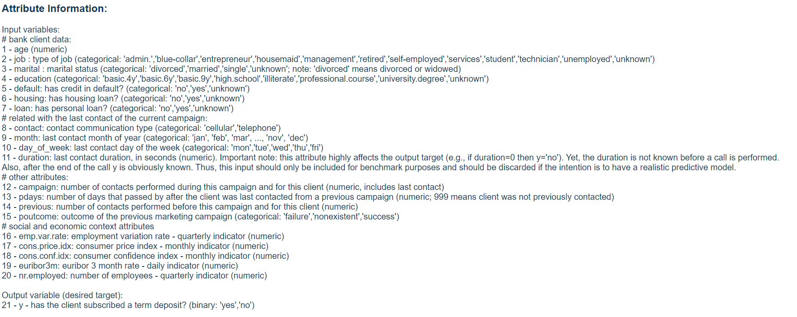
Dataset description
The dataset we are performing analysis on is bank-additional-full.csv with all examples (41188) and 20 inputs calls made between May 2008 and November 2010
It contains 20 independent variables out of which 10 are numeric features and 10 are categorical features.
Subscribed is our target variable which records two responses: ‘Yes’ (indicating whether the customer subscribed to the term deposit) or ‘No (whether they did not subscribe)
Full variable information can be found on the data source website:
https://archive.ics.uci.edu/ml/datasets/bank+marketing

Slide 6
Business objective
Exploring patterns and anomalies in the calling patterns, how distributed are the marketing efforts towards wide section of the customers
Data Exploration
We are interested in knowing how the marketing efforts are translating to results. Quantification of results through visuals would make the business aware of how the marketing efforts are resulting
Outcomes of the Campaign
Process Improvements
Suggest scope of improvements in the marketing campaigns based on the outcomes of the efforts. Make suggestions based on various attributes of the data available.

Slide 7
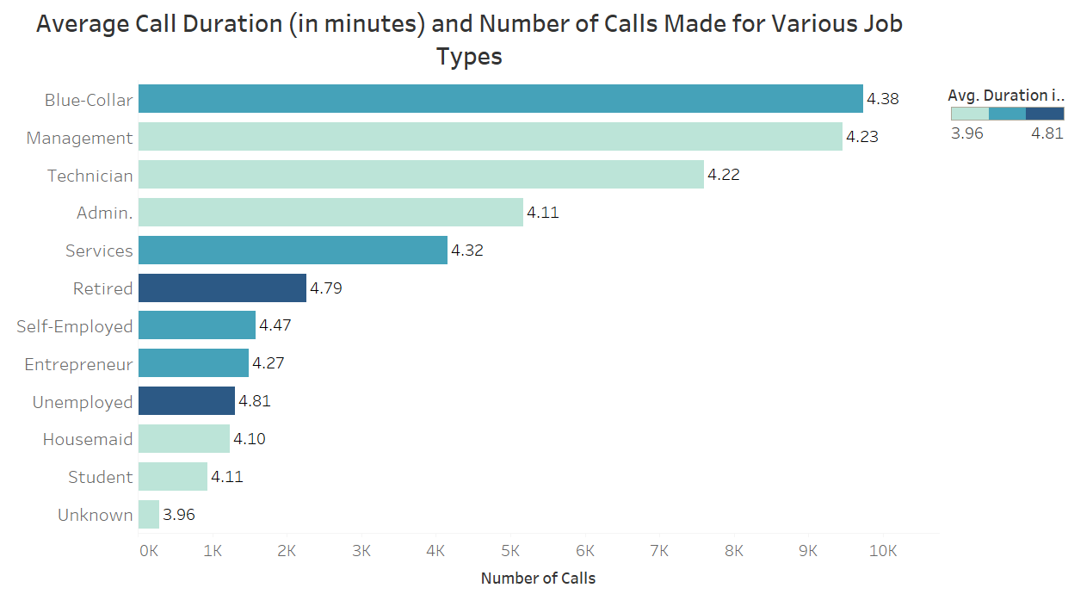
Calling activity distribution across various job roles of customers
Plot Summary:
We are plotting frequency of calls made to customers based on their professions. Additionally, we have color attributed the average duration of calls made to each profession.
Observation:
Blue-collared customers are called more often but retired and unemployed customers have higher call duration

Slide 8
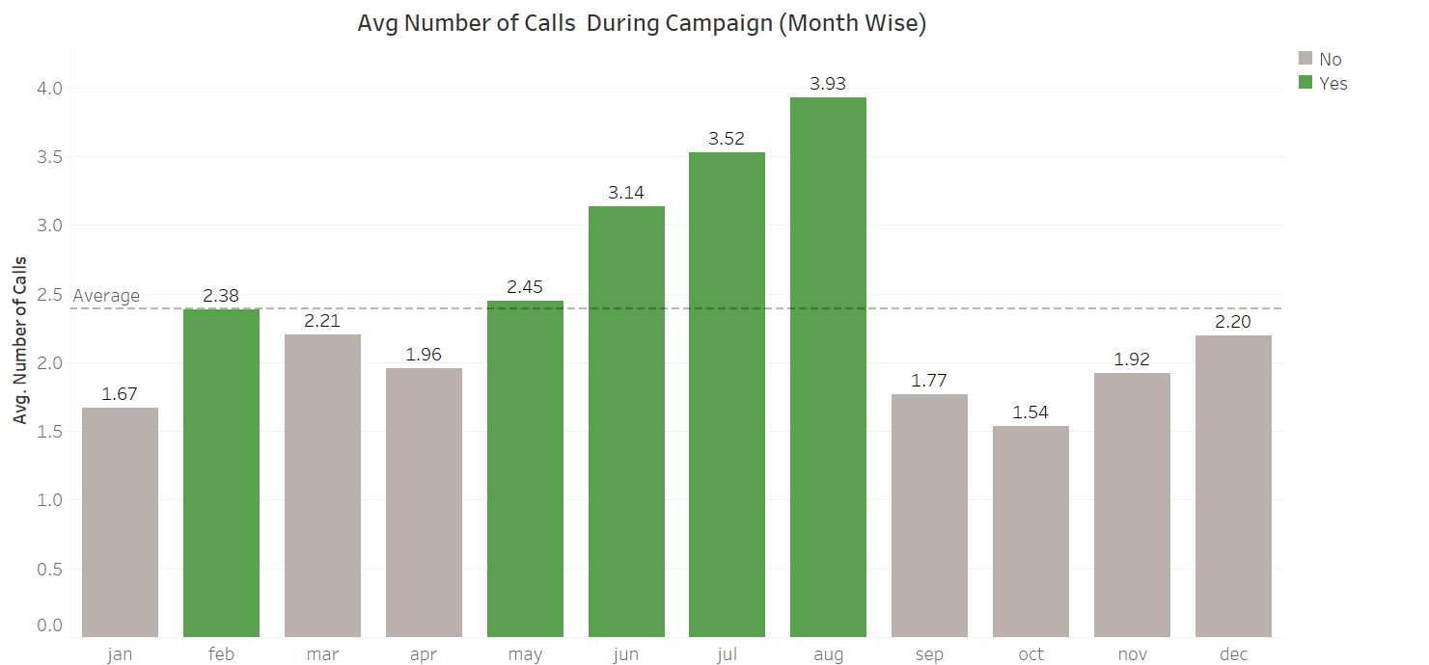
Call frequency distribution across months
Plot Summary:
We are plotting frequency of average number of calls made to customers based during different months of the year. We have plotted an yearly average of 2.38 calls per customers during the year
Observation:
May-Aug months witness above average number of calls made to customers, with August having highest count among all months.

Slide 9
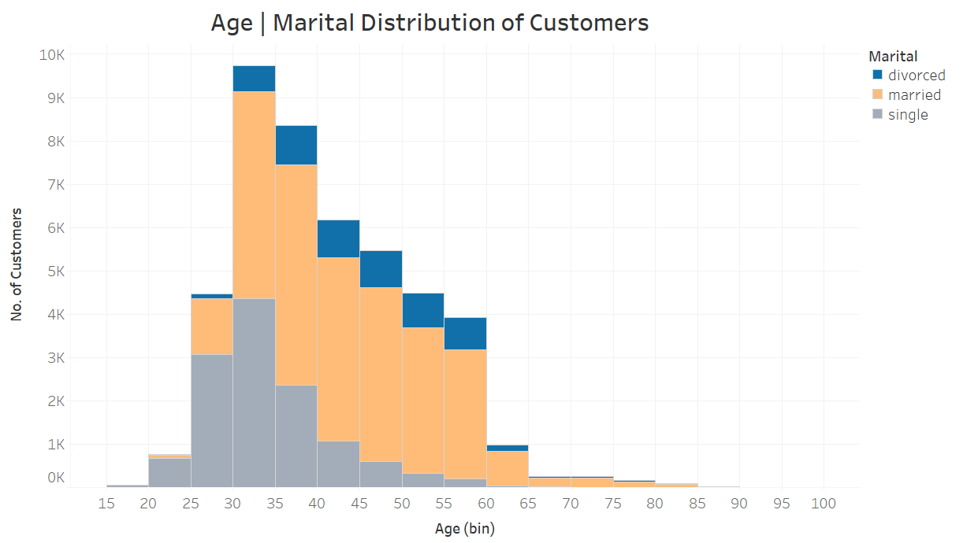
Call frequency distribution across months
Plot Summary:
We are plotting age and marital status distribution of the customers. This is an important demographic attribute for the analysis.
Observation:
We observe a close to normal distribution in terms of age with major customers in 30 to 40 age group. As the age goes up from 20, married composition increases.

Slide 10
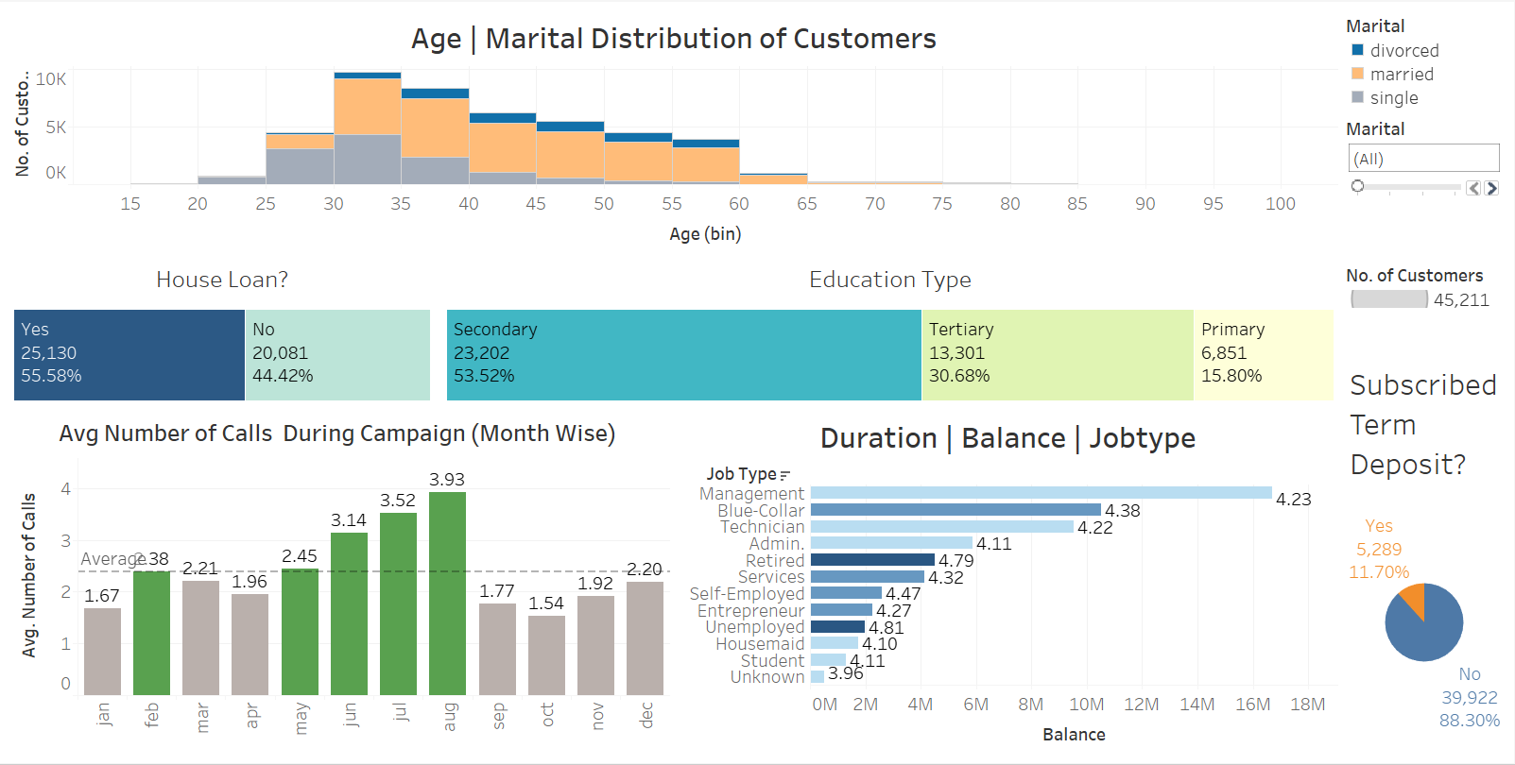
Dashboarding: Putting it all together
Plot Summary:
We have complied all charts related to demographics and marketing activity data available. We have visualized the target variable ‘Subscribed’ to show the interaction of variables how the target variable changes.
It enables us to understand how each variable influences the subscription to the term deposit by a customer.

Slide 11
THANK YOU
Akshay Gera
akshay1604@gmail.com
https://github.com/akshay-gera

